Slide 1
Measures of Central Tendency (1)
Md. Ismail Hossain Riday

Slide 2
Descriptive measures
In previous chapter, we discussed how a raw data set can be organized and summarized by tables and graphs.
Another method of summarizing data set precisely is to compute number (a single number).
Number that can be describe data sets are called descriptive measures

Slide 3
Descriptive measures
Four types of descriptive measure
Measures of central tendency
Measures of Location
Measures of Dispersion
Shape of the distribution
It is a summary measure.
Attempts to describe the whole data set with a single value.
Represents the center of the distribution.

Slide 4
Types of C.T.
Mean
Median
Mode

Slide 5
Types of mean
Arithmetic mean
Geometric mean
Harmonic mean

Slide 6
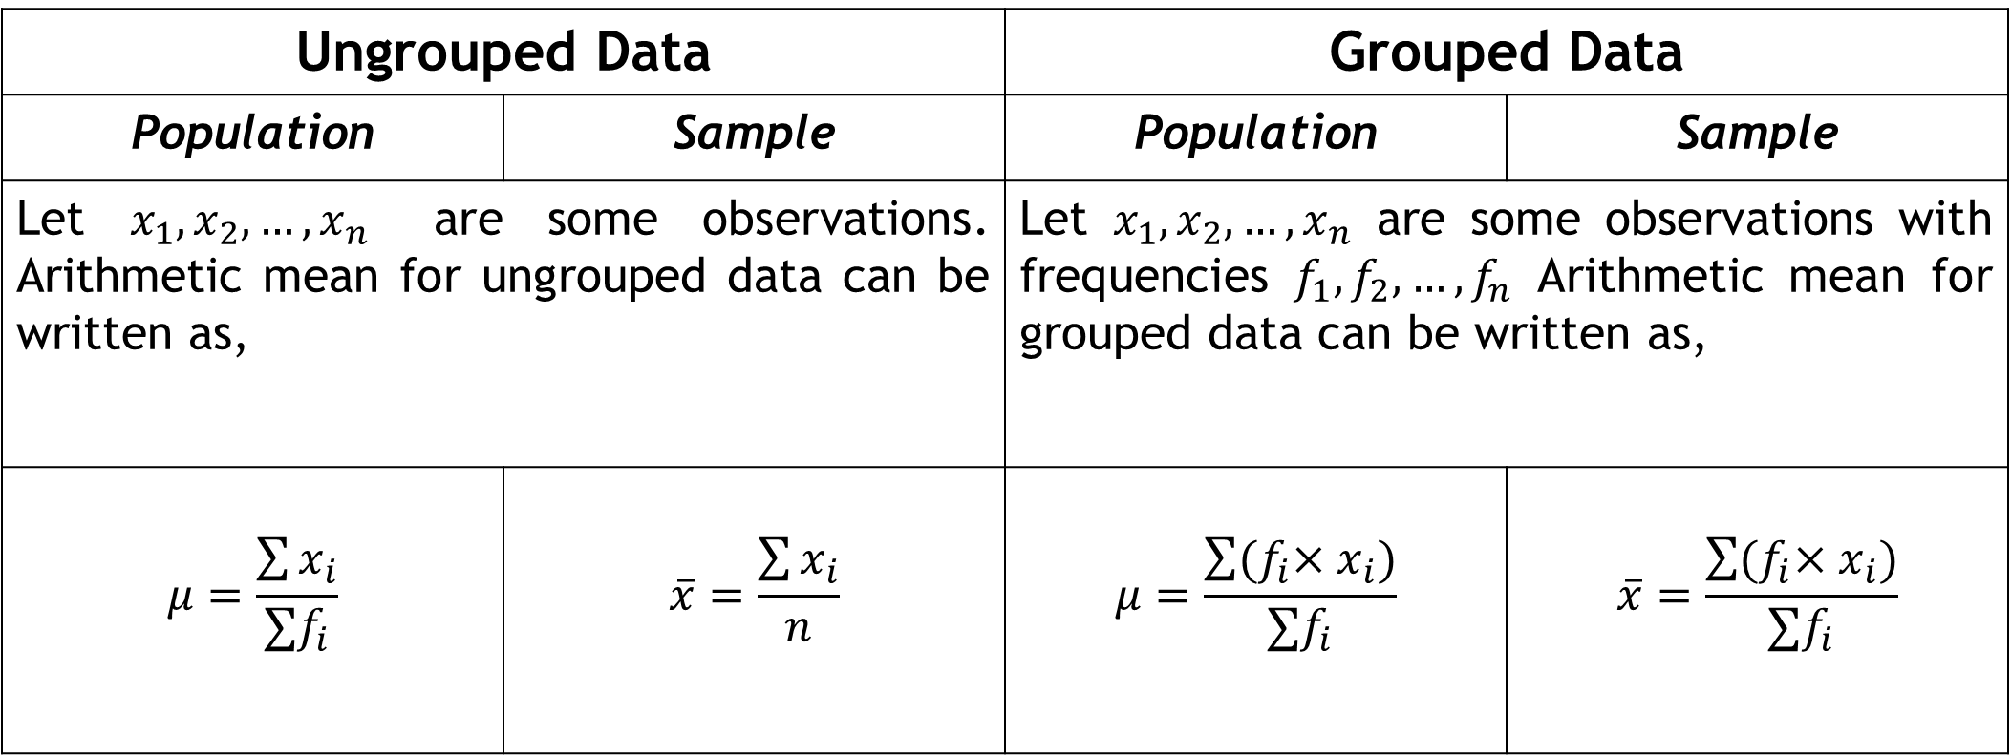
Arithmetic Mean
Ungrouped Data |  | Grouped Data
Population | Sample | Population | Sample
Let $x_{1}, x_{2},…, x_{n}$ are some observations. Arithmetic mean for ungrouped data can be written as, |  | Let $x_{1}, x_{2},…, x_{n}$ are some observations with frequencies $f_{1},f_{2},…,f_{n}$ Arithmetic mean for grouped data can be written as,
$$μ=\frac{\sum{x_{i}}}{∑f_{i}}$$ | $$\overline{x}=\frac{\sum{x_{i}}}{n}$$ | $$μ=\frac{\sum{{{(f}_{i}×x}_{i})}}{∑f_{i}}$$ | $$\overline{x}=\frac{\sum{{{(f}_{i}×x}_{i})}}{∑f_{i}}$$
$$∑f_{i}=N=Total number frequency$$

Slide 7
Ungroup data: AM
The Sun Times reported the following car prices for a sample of cars sold in Phoenix, AZ, during the previous month (in $1000s): 25, 30, 22, 28, 35, 40, 18, 26, 32, 29. Calculate and interpret the sample mean.
The sample mean of 180 observations is 7. But on comparing the original data, it was found that an observation 12 was misreported as 21 in the computation. Compute the correct mean.
Ans: 28.5; Average car price is 28500$

Slide 8
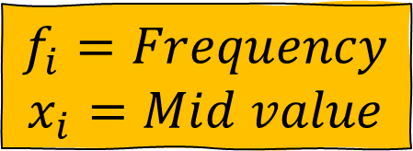
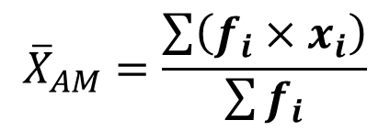
Group data: AM
Class | Frequency
5-9 | 4
9-13 | 3
13-17 | 3
17-21 | 3
$$f_{i}=Frequency$$
$$x_{i}=Mid value$$
Calculate mean or arithmetic mean or average from this table…
$${\overline{X}}_{AM}=\frac{\sum{\left(f_{i}×x_{i}\right)}}{\sum{f_{i}}}$$

Slide 9
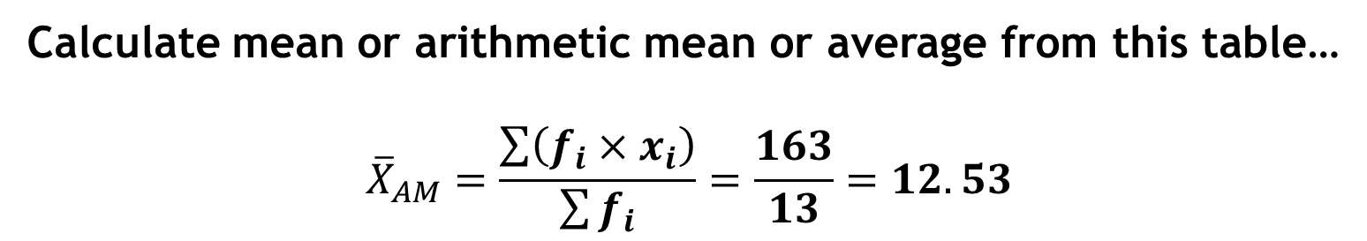
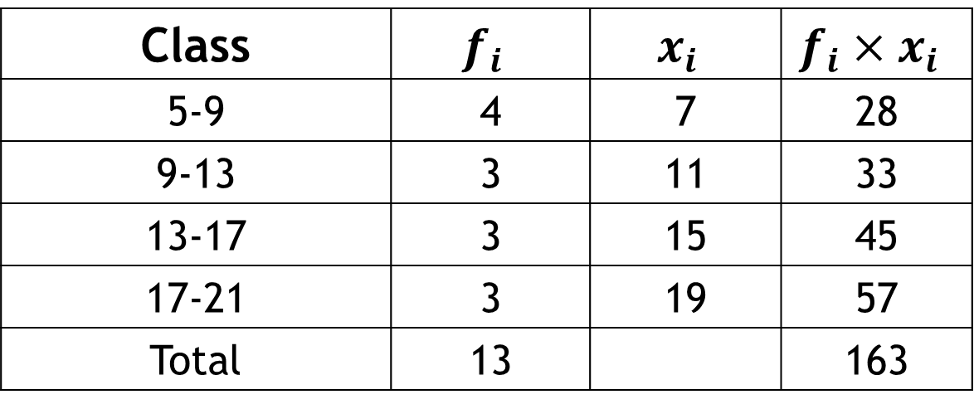
Group data: AM
Class | $$f_{i}$$ | $$x_{i}$$ | $$f_{i}×x_{i}$$
5-9 | 4 | 7 | 28
9-13 | 3 | 11 | 33
13-17 | 3 | 15 | 45
17-21 | 3 | 19 | 57
Total | 13 |  | 163
Calculate mean or arithmetic mean or average from this table…
$${\overline{X}}_{AM}=\frac{\sum{\left(f_{i}×x_{i}\right)}}{\sum{f_{i}}}=\frac{163}{13}=12.53$$

Slide 10
Group data: AM
Construct a frequency distribution table based on the given information.
Calculate the mean debugging time using the given data.
A software company is analyzing the time spent by its developers on debugging tasks. To understand the distribution of debugging hours among employees, the company categorized the total hours into different intervals. After collecting data from various teams, they observed that three employees spent between 5 to 9 hours debugging code. Similarly, four employees reported spending between 9 to 13 hours, while another four employees fell into the 13 to 17-hour range. Lastly, two employees spent between 17 to 21 hours debugging.

Slide 11
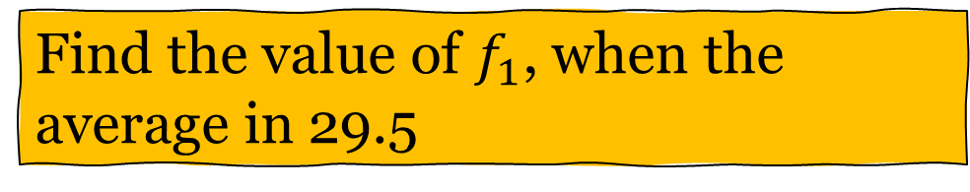
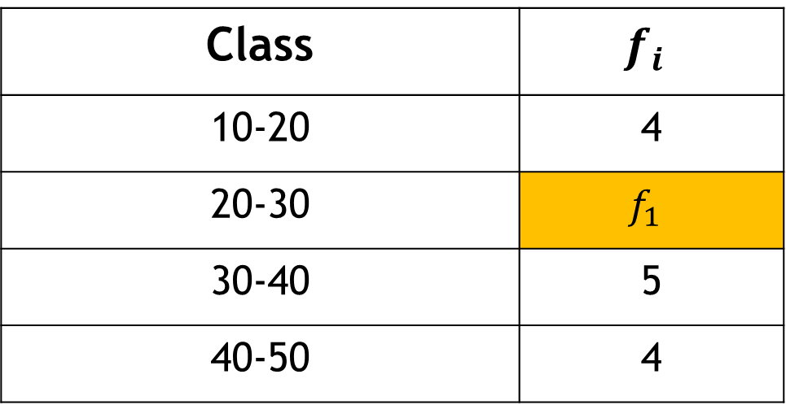
Group data: AM
Class | $$f_{i}$$
10-20 | 4
20-30 | $$f_{1}$$
30-40 | 5
40-50 | 4
Find the value of $f_{1}$, when the average in 29.5

Slide 12
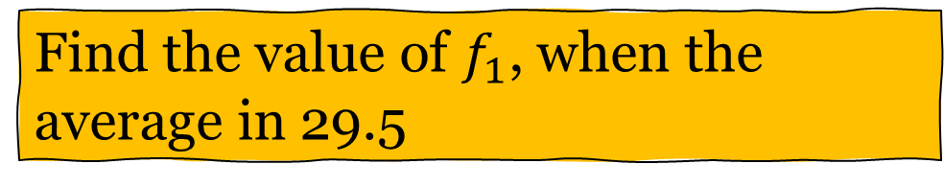
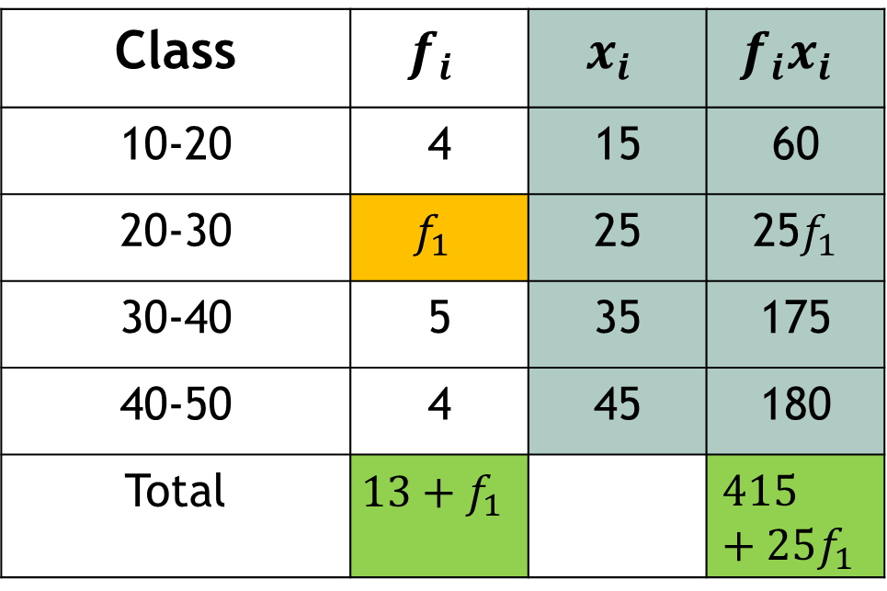
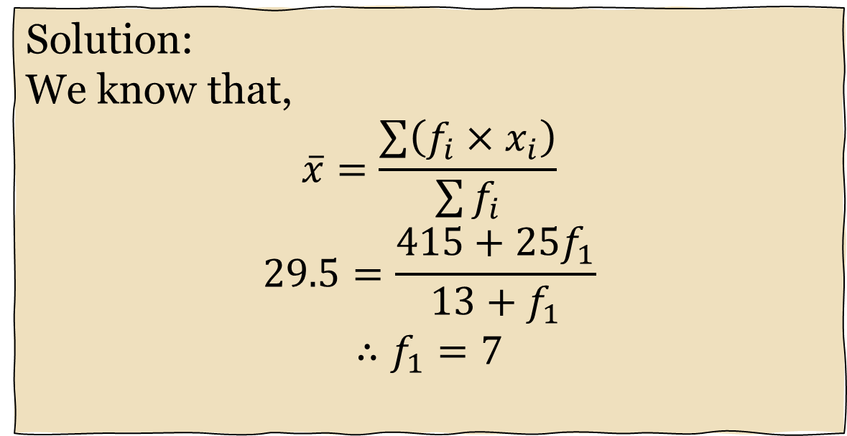
Group data: AM
Class | $$f_{i}$$ | $$x_{i}$$ | $$f_{i}x_{i}$$
10-20 | 4 | 15 | 60
20-30 | $$f_{1}$$ | 25 | 25$f_{1}$
30-40 | 5 | 35 | 175
40-50 | 4 | 45 | 180
Total | $$13+f_{1}$$ |  | $$415+25f_{1}$$
Solution:
We know that,
$$\overline{x}=\frac{\sum{\left(f_{i}×x_{i}\right)}}{\sum{f_{i}}}$$
$$29.5=\frac{415+25f_{1}}{13+f_{1}}$$
$$∴f_{1}=7$$
Find the value of $f_{1}$, when the average in 29.5

Slide 13
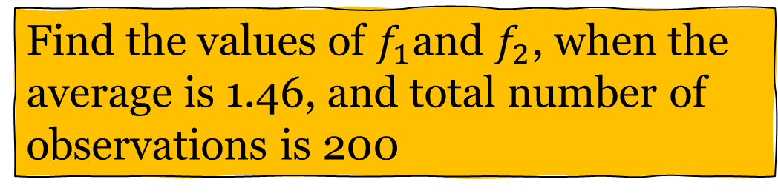
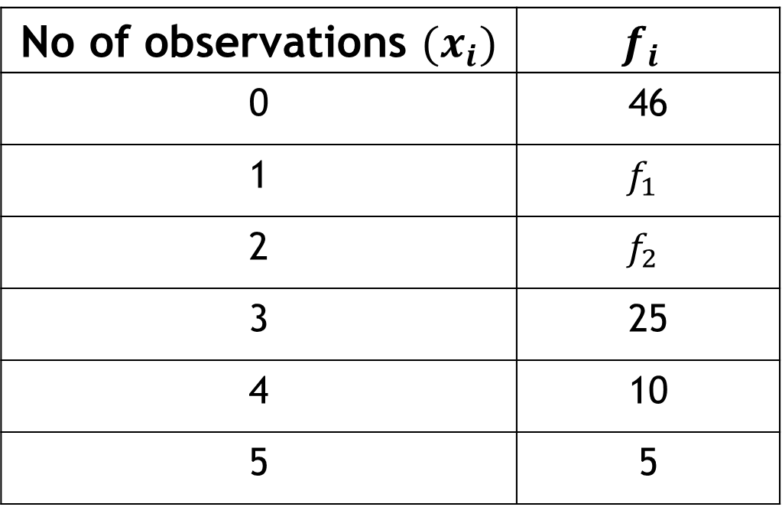
Self Practice!!!
No of observations $(x_{i})$ | $$f_{i}$$
0 | 46
1 | $$f_{1}$$
2 | $$f_{2}$$
3 | 25
4 | 10
5 | 5
Find the values of $f_{1}$and $f_{2}$, when the average is 1.46, and total number of observations is 200

Slide 14
Geometric Mean
It is useful when dealing with data that exhibits
Exponential growth, or
Growth over the year/ change over a period of times, or
Geometric progression

Slide 15
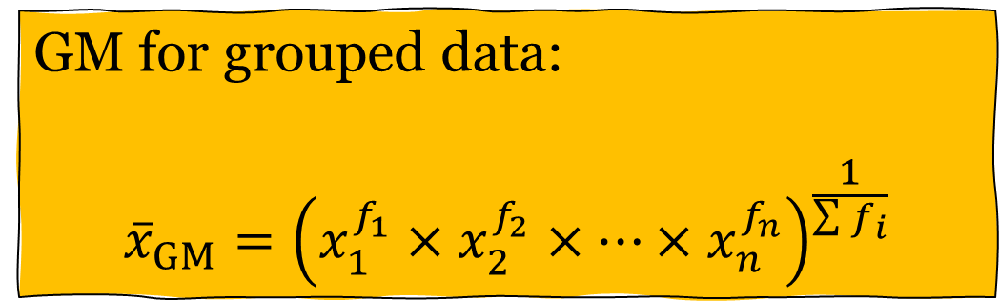
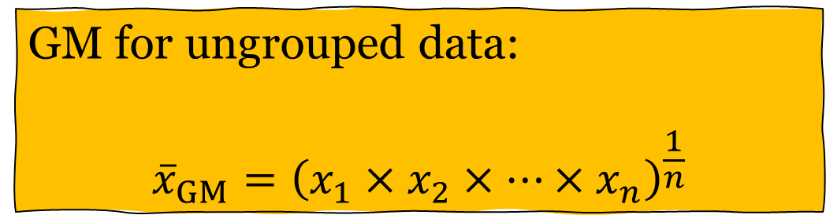
Geometric Mean
GM for ungrouped data:
$${\overline{x}}_{GM}={\left(x_{1}×x_{2}×…×x_{n}\right)}^{\frac{1}{n}}$$
GM for grouped data:
$${\overline{x}}_{GM}={\left(x_{1}^{f_{1}}×x_{2}^{f_{2}}×…×x_{n}^{f_{n}}\right)}^{\frac{1}{\sum{f_{i}}}}$$

Slide 16

Geometric Mean
For example: 5, 3, 9, 2, 7, 5, 8
${\overline{X}}_{GM}={\left(5×3×9×2×7×5×8\right)}^{\frac{1}{7}}=4.98$

Slide 17

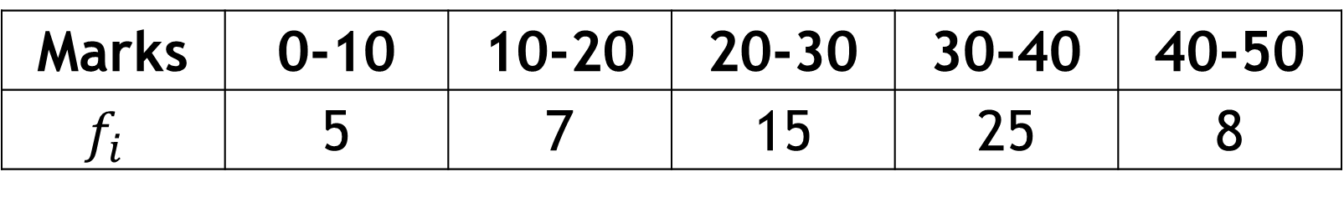
Geometric Mean
Find the geometric mean for the following distribution:
Marks | 0-10 | 10-20 | 20-30 | 30-40 | 40-50
$$f_{i}$$ | 5 | 7 | 15 | 25 | 8
GM for grouped data:
$${\overline{x}}_{GM}={\left(x_{1}^{f_{1}}×x_{2}^{f_{2}}×…×x_{n}^{f_{n}}\right)}^{\frac{1}{\sum{f_{i}}}}$$

Slide 18


Harmonic Mean
It is necessary to compute the average of some variables such as the average speed, average velocity, and so on.
HM for ungrouped data:
$$\overline{X}=\frac{n}{\frac{1}{x_{1}}+\frac{1}{x_{2}}+…+\frac{1}{x_{n}}}$$
HM for grouped data:
$$\overline{X}=\frac{\sum{f_{i}}}{\frac{f_{1}}{x_{1}}+\frac{f_{2}}{x_{2}}+…+\frac{f_{n}}{x_{n}}}$$

Slide 19

Harmonic Mean
For example: 5, 3, 9, 2, 7, 5, 8
${\overline{X}}_{HM}=\frac{7}{\frac{1}{5}+\frac{1}{3}+…+\frac{1}{8}}=(???)$

Slide 20
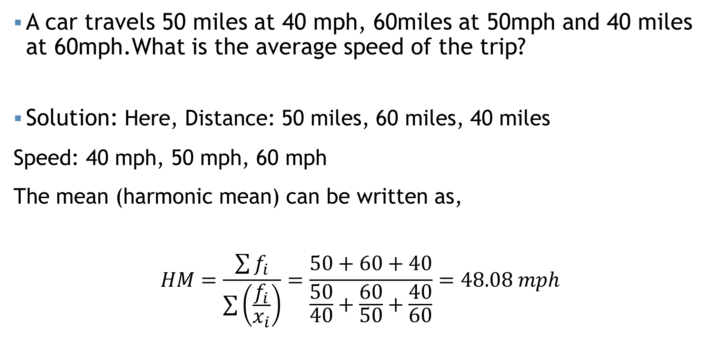
Harmonic Mean
A car travels 50 miles at 40 mph, 60miles at 50mph and 40 miles at 60mph.What is the average speed of the trip?
Solution: Here, Distance: 50 miles, 60 miles, 40 miles
Speed: 40 mph, 50 mph, 60 mph
The mean (harmonic mean) can be written as,
$$HM=\frac{\sum{f_{i}}}{\sum{\left(\frac{f_{i}}{x_{i}}\right)}}=\frac{50+60+40}{\frac{50}{40}+\frac{60}{50}+\frac{40}{60}}=48.08 mph$$

Slide 21
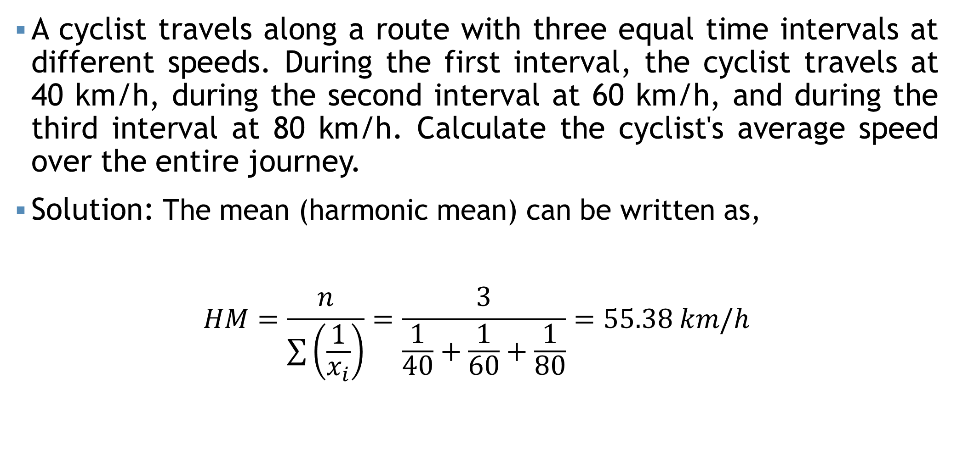
Harmonic Mean
A cyclist travels along a route with three equal time intervals at different speeds. During the first interval, the cyclist travels at 40 km/h, during the second interval at 60 km/h, and during the third interval at 80 km/h. Calculate the cyclist's average speed over the entire journey.
Solution: The mean (harmonic mean) can be written as,
$$HM=\frac{n}{\sum{\left(\frac{1}{x_{i}}\right)}}=\frac{3}{\frac{1}{40}+\frac{1}{60}+\frac{1}{80}}=55.38 km/h$$

Slide 22
Self Practice!!!
A researcher observed a runner completing a marathon at four different speeds. The initial 5 miles were covered at a speed of 5 mph, the next 10 miles were completed at 10 mph, and the final 5 miles were also covered at 10 mph. The researcher discovered that the runner's speed for the third portion was 12 mph, but the distance of that part was unknown.
If the researcher wishes to calculate the average speed of the runner, which measures of central tendency would be suitable in this context?
If the runner maintains an average speed of 9 mph, determine the distance of the third portion of the race.
Calculate the corrected average speed of the runner if the speed for the third portion is 8 mph.

Slide 23

Some points…
$AM≥GM≥HM$
$GM=\sqrt{AM×HM}$

Slide 24
Weighted mean
The weighted mean is a special case of the arithmetic mean. It occurs when there are several observations of the same value.
To explain- Suppose the ABC’s Hot Cake offers three different kinds of burger packages small, medium and large for Tk. 100, Tk. 125 and Tk. 150. Of the last 10 burgers sold 3 were small, 4 were medium and 3 were large. To find the mean price of the last 10 burger packages sold we can calculate using the usual formula of the arithmetic mean as follows
$${\overline{X}}_{AM}=\frac{\left(100+100+100+125+125+125+125+150+150+150\right)}{10}=125$$

Slide 25
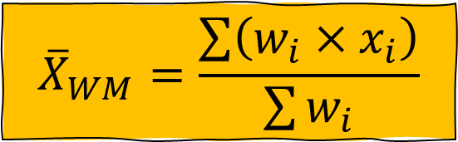
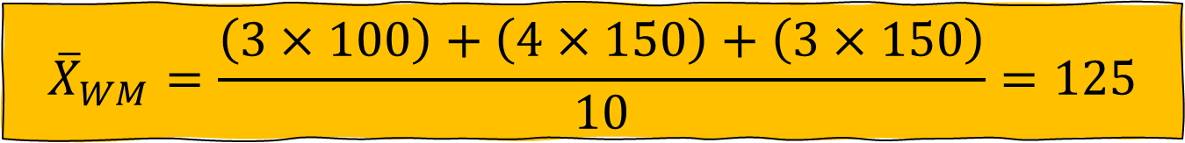
Weighted mean
$${\overline{X}}_{WM}=\frac{\sum{\left(w_{i}×x_{i}\right)}}{\sum{w_{i}}}$$
An easier way to find the mean selling price is to determine the weighted mean.
$${\overline{X}}_{WM}=\frac{\left(3×100\right)+\left(4×150\right)+\left(3×150\right)}{10}=125$$

Slide 26
Weighted mean
Madina Construction Company pays its part time employees hourly basis. For different level of employee, the hourly rate is Tk 50, Tk 75 and Tk 90. There are 260 hourly employees, 140 of which are paid at Tk 50 rate, 100 at Tk 75 and 20 at the Tk 90 rate What is the mean hourly rate paid to the employees?

Slide 27
Weighted mean
A shopper allocates $300 each month to buy fruits. Over a period of five months, the prices of apples are $2.50, $3.00, $2.20, $2.80, and $3.50 per pound. After five months, what is the average price per pound of apples paid by the shopper?

Slide 28
Self Practice!!!
a. Construct a table and calculate frequency, cumulative frequency from this graph, when the total number of observations is 60
b. Using table from (a), calculate the average number of E-device per home.

Slide 29
Median
Middle value of the observation.
After they have been arranged/ordered from smallest to largest.

Slide 30

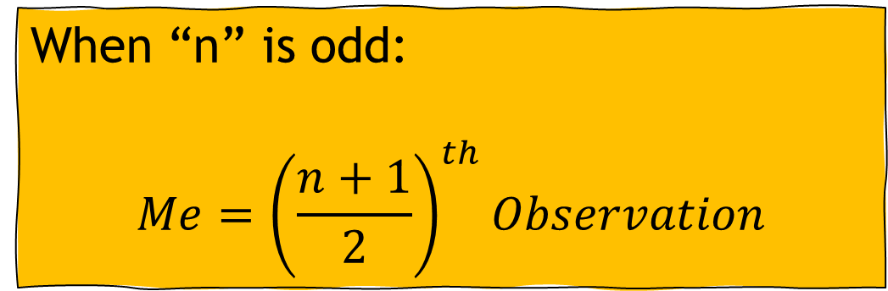
Median for Ungrouped data
There are two types of formula for ungrouped data
When “n” is odd:
$$Me={\left(\frac{n+1}{2}\right)}^{th}Observation$$
When “n” is even:
$$Me=\frac{{\left(\frac{n}{2}\right)}^{th}Obs.+{\left(\frac{n}{2}+1\right)}^{th}Obs.}{2}$$

Slide 31
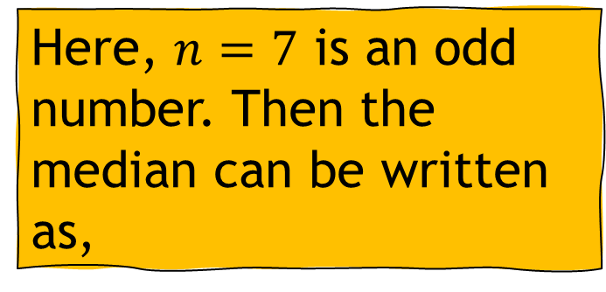
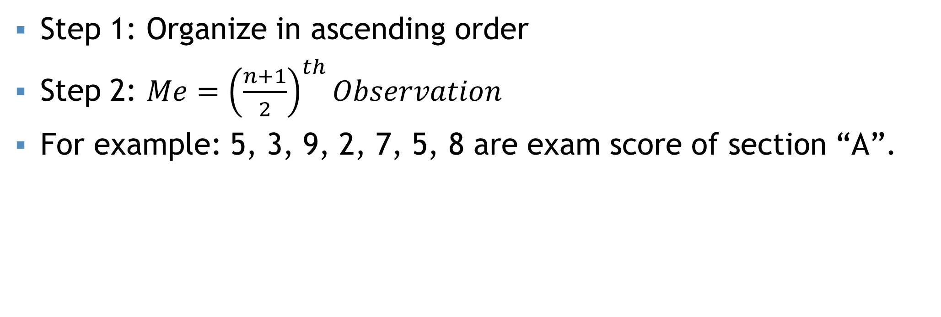

“n” is odd
Step 1: Organize in ascending order
Step 2: $Me={\left(\frac{n+1}{2}\right)}^{th}Observation$
For example: 5, 3, 9, 2, 7, 5, 8 are exam score of section “A”.
Organize in ascending order:
2, 3, 5, 5, 7, 8, 9
Here, $n=7$ is an odd number. Then the median can be written as,
$$Me={\left(\frac{n+1}{2}\right)}^{th}Obs.$$
$$∴Me=5$$
Comment: The median score of section “A” is 5

Slide 32
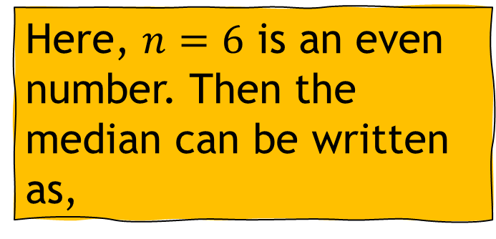
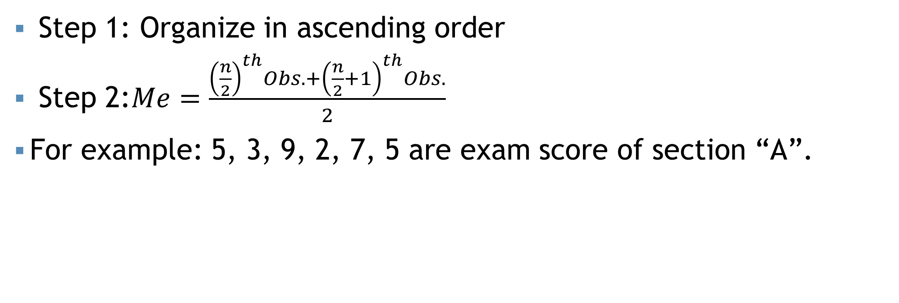

“n” is even
Step 1: Organize in ascending order
Step 2:$Me=\frac{{\left(\frac{n}{2}\right)}^{th}Obs.+{\left(\frac{n}{2}+1\right)}^{th}Obs.}{2}$
For example: 5, 3, 9, 2, 7, 5 are exam score of section “A”.
Organize in ascending order:
2, 3, 5, 5, 7, 9
Here, $n=6$ is an even number. Then the median can be written as,
$$Me=5$$
Comment: The median score of section “A” is 5

Slide 33
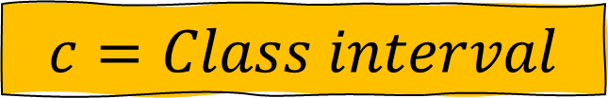
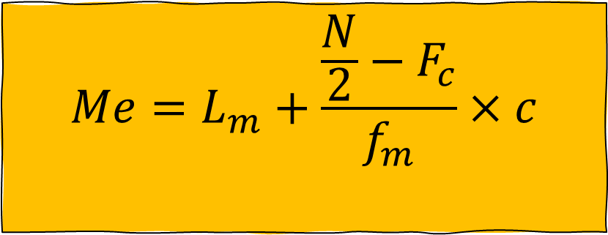
Median for grouped data
$$Me=L_{m}+\frac{\frac{N}{2}−F_{c}}{f_{m}}×c$$
$$L_{m}=Lower limit of median class$$
$$N=Total number of observations$$
$$F_{c}=Cumultative frequency of pre−median class$$
$$f_{m}=Frequency of median class$$
$$c=Class interval$$

Slide 34
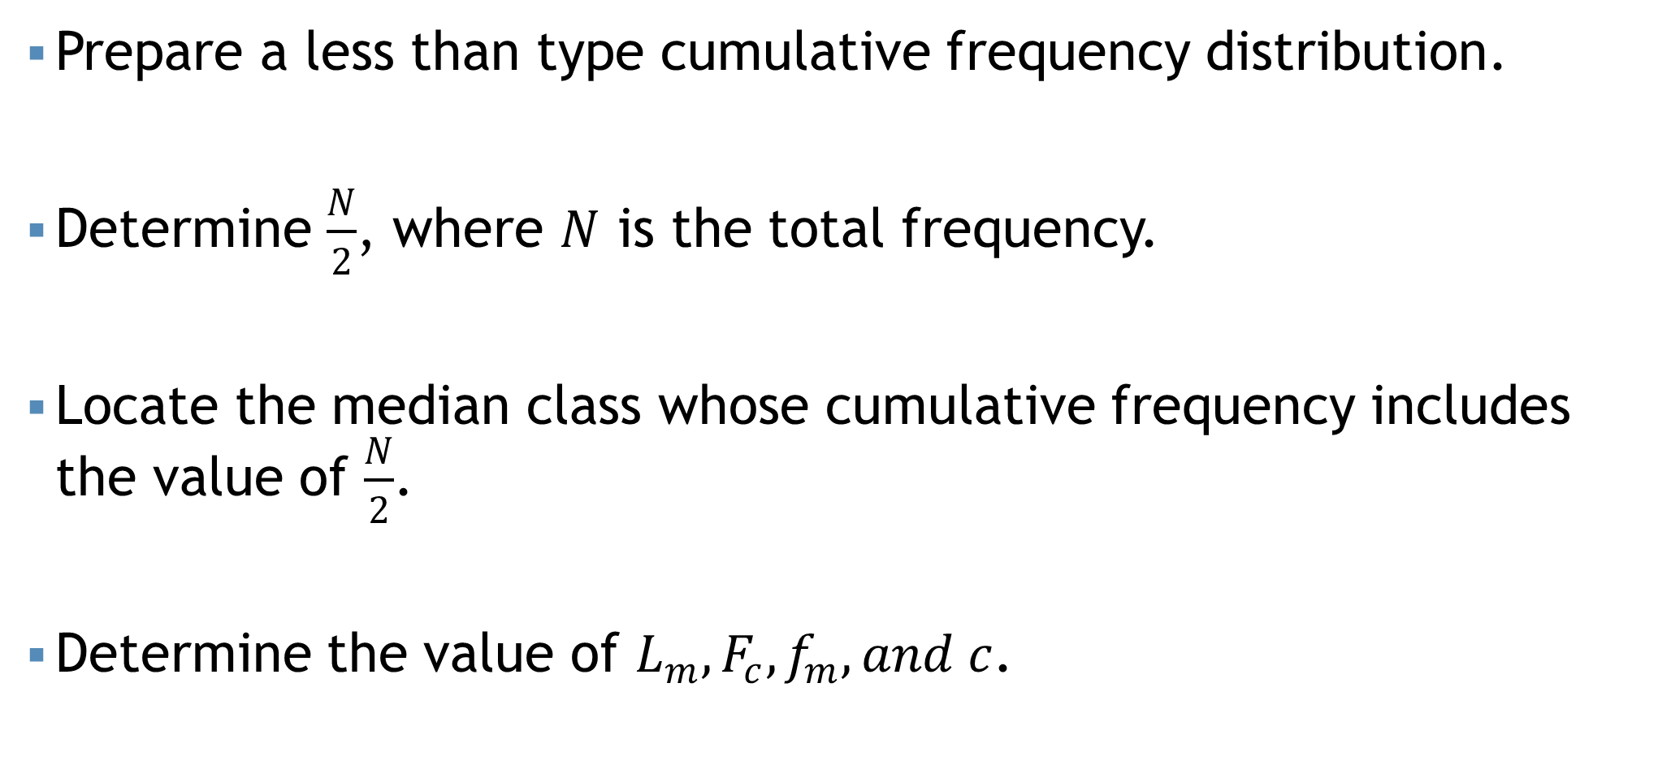
Steps…
Prepare a less than type cumulative frequency distribution.
Determine $\frac{N}{2}$, where $N$ is the total frequency.
Locate the median class whose cumulative frequency includes the value of $\frac{N}{2}$.
Determine the value of $L_{m},F_{c},f_{m}, and c$.

Slide 35
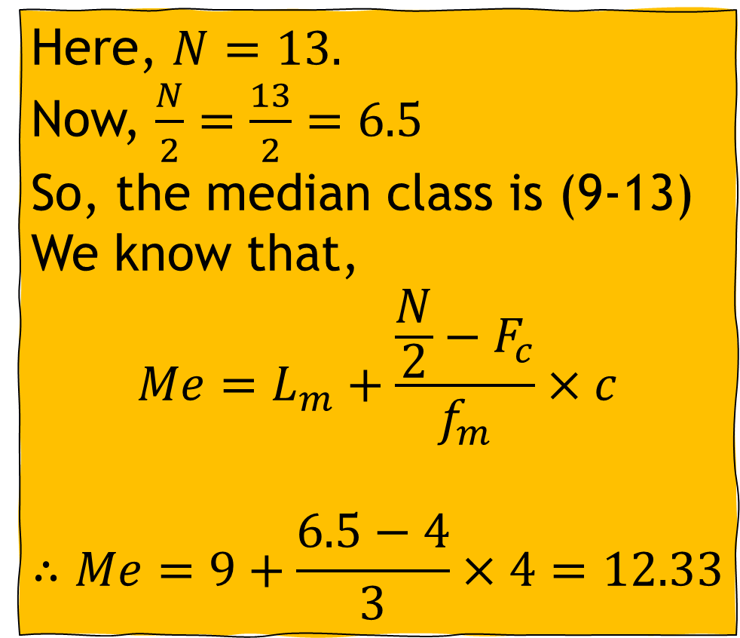
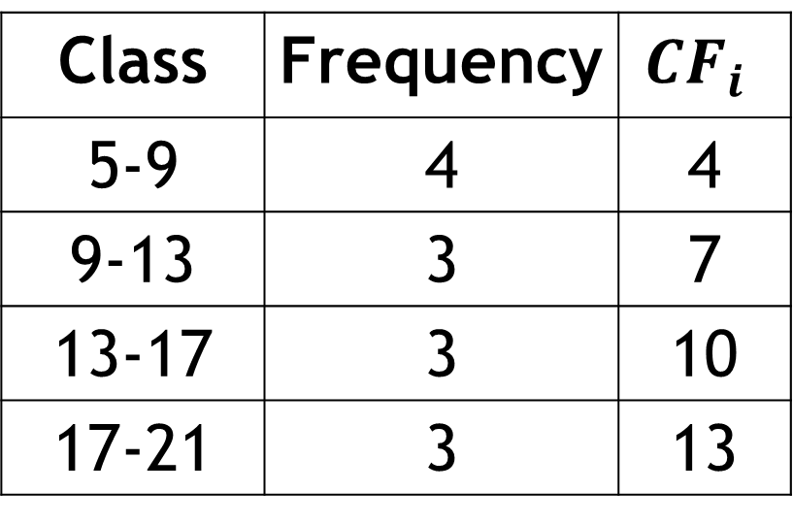
Median for grouped data
Class | Frequency | $$CF_{i}$$
5-9 | 4 | 4
9-13 | 3 | 7
13-17 | 3 | 10
17-21 | 3 | 13
Here, $N=13.$
Now, $\frac{N}{2}=\frac{13}{2}=6.5$
So, the median class is (9-13)
We know that,
$$Me=L_{m}+\frac{\frac{N}{2}−F_{c}}{f_{m}}×c$$
$$∴Me=9+\frac{6.5−4}{3}×4=12.33$$

Slide 36
Mode
One mode = Unimodal
Two mode = Bi-modal
More than two = Multimodal
Most frequent value
Occurs more than one times.
For example: 1, 2, 2, 5, 5, 3, 6, 6, 6, 4
Here the most frequent value is 6.
Thus the mode value is 6, and this is a unimodal data.

Slide 37
Mode
Example: 1, 2, 3, 4, 5, 6, 7, 8, 9, 10
There is no value which occur more than one time. Thus, there is no “Mode” in this data set.

Slide 38
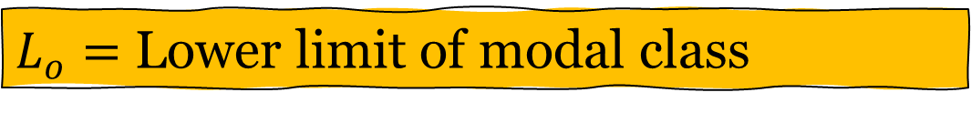
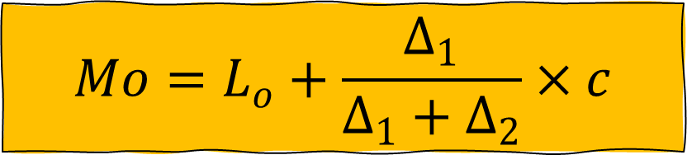
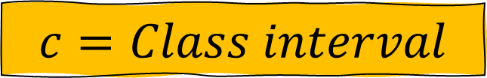
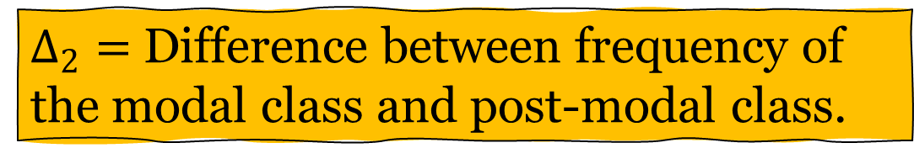
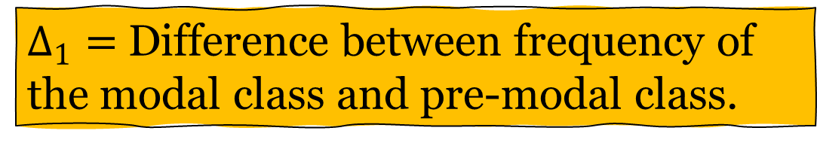
Mode for grouped data
$$Mo=L_{o}+\frac{Δ_{1}}{Δ_{1}+Δ_{2}}×c$$
$L_{o}=$ Lower limit of modal class
$Δ_{1}=$ Difference between frequency of the modal class and pre-modal class.
$Δ_{2}=$ Difference between frequency of the modal class and post-modal class.
$$c=Class interval$$

Slide 39
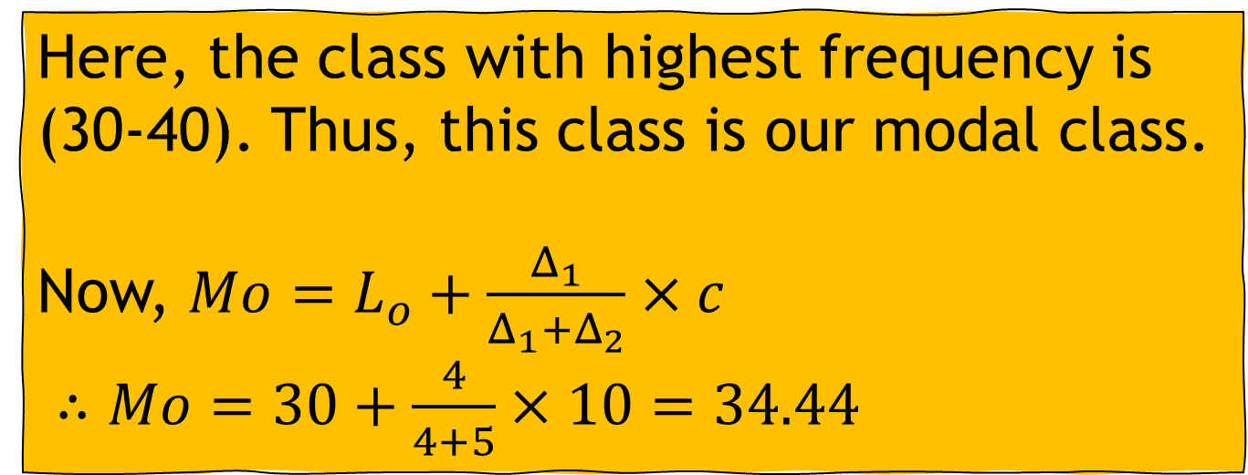
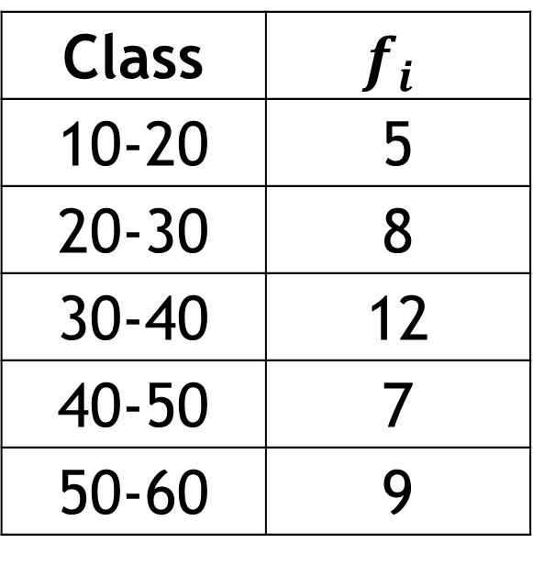
Mode for grouped data
Class | $$f_{i}$$
10-20 | 5
20-30 | 8
30-40 | 12
40-50 | 7
50-60 | 9
Here, the class with highest frequency is (30-40). Thus, this class is our modal class.
Now, $Mo=L_{o}+\frac{Δ_{1}}{Δ_{1}+Δ_{2}}×c$
$∴Mo=30+\frac{4}{4+5}×10=34.44$

Slide 40
Some points…
Does all data have a Mean, median, and mode?
Every set of continuous data possesses a median, mode, and mean.
When considering ordinal data, it encompasses solely a median and mode.
Nominal data solely involves a mode

Slide 41
Mathematical exercise
To access additional mathematical problems, please refer to the PDF lecture notes and Books.

Slide 42
Thank You

